Slide 1
Roulette
Bailey Korfhage

Slide 2
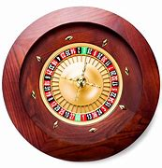
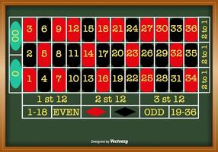
How to play
Roulette is a game of chance that involves betting on 38 numbers or different divisions of the numbers on the board.
You can choose an individual number, one column, one section of dozens, one of the halves, odds or evens, and red or black.
The payout is determined on the odds of the ball landing on the number.
A ball is then spun around the wheel to determine the winning number.

Slide 3
Building Blocks
Class
Random
__init__
self
Function
Print
User input
List
Conditional statements
Global
While loop
Formatted string

